Slide 1
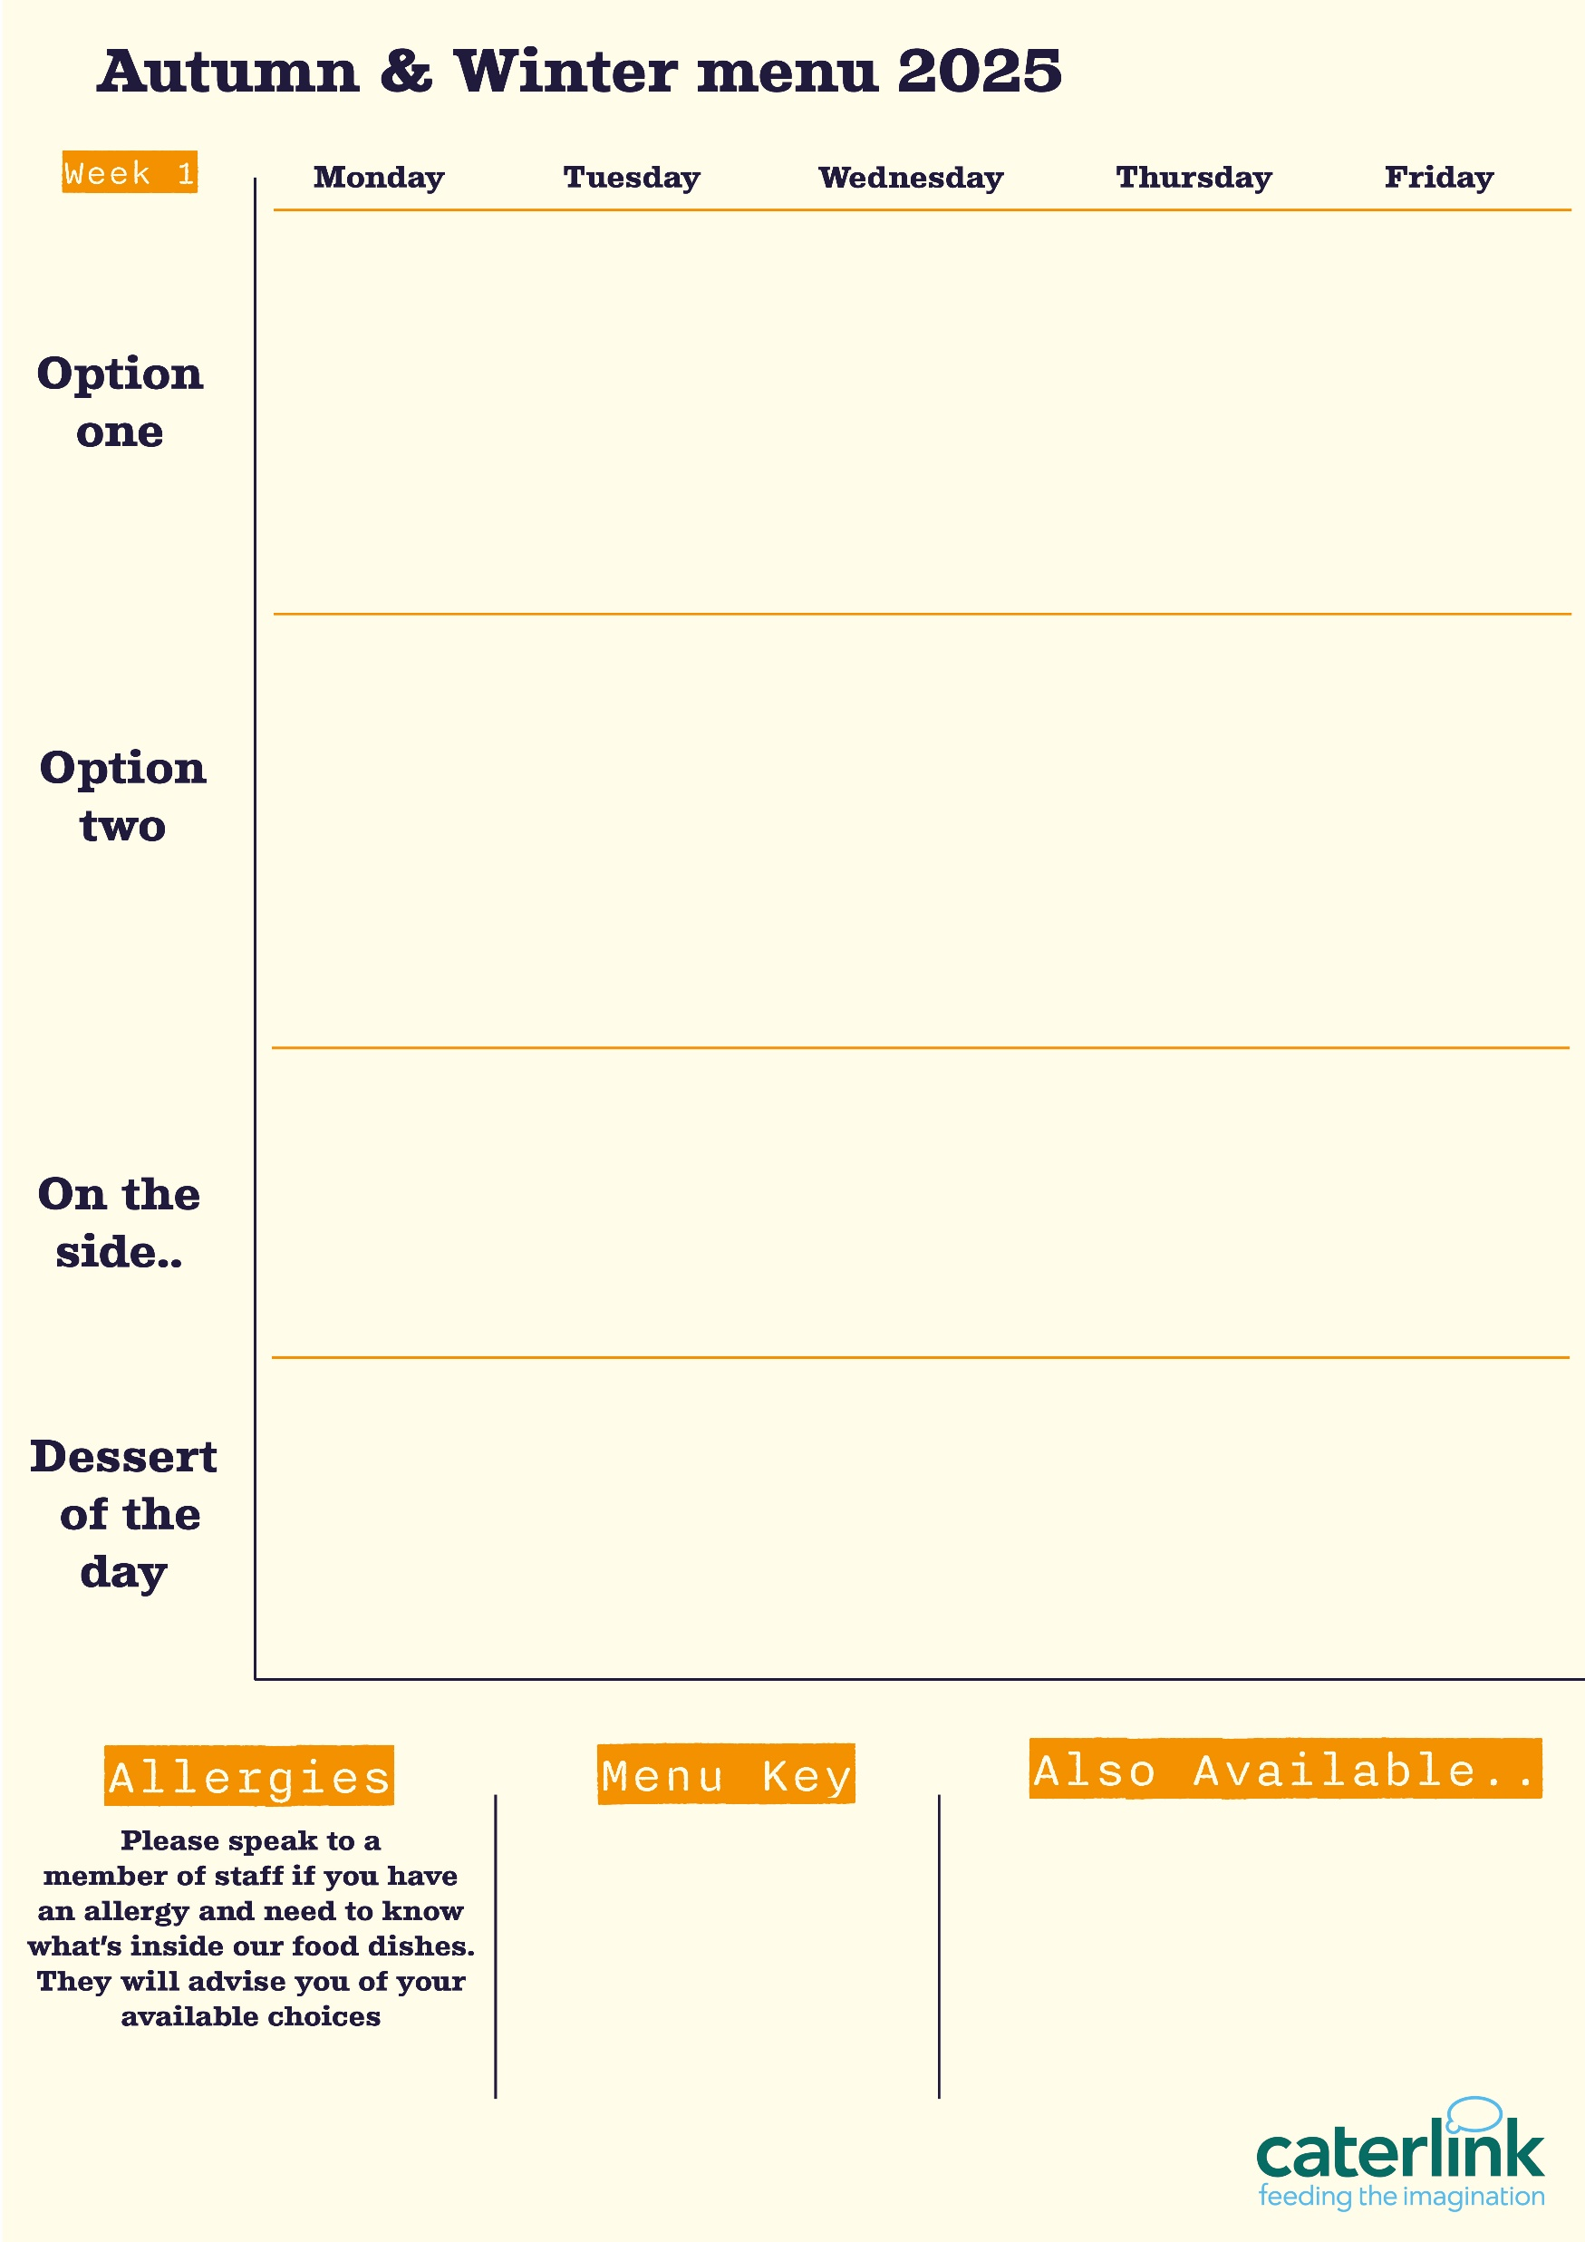
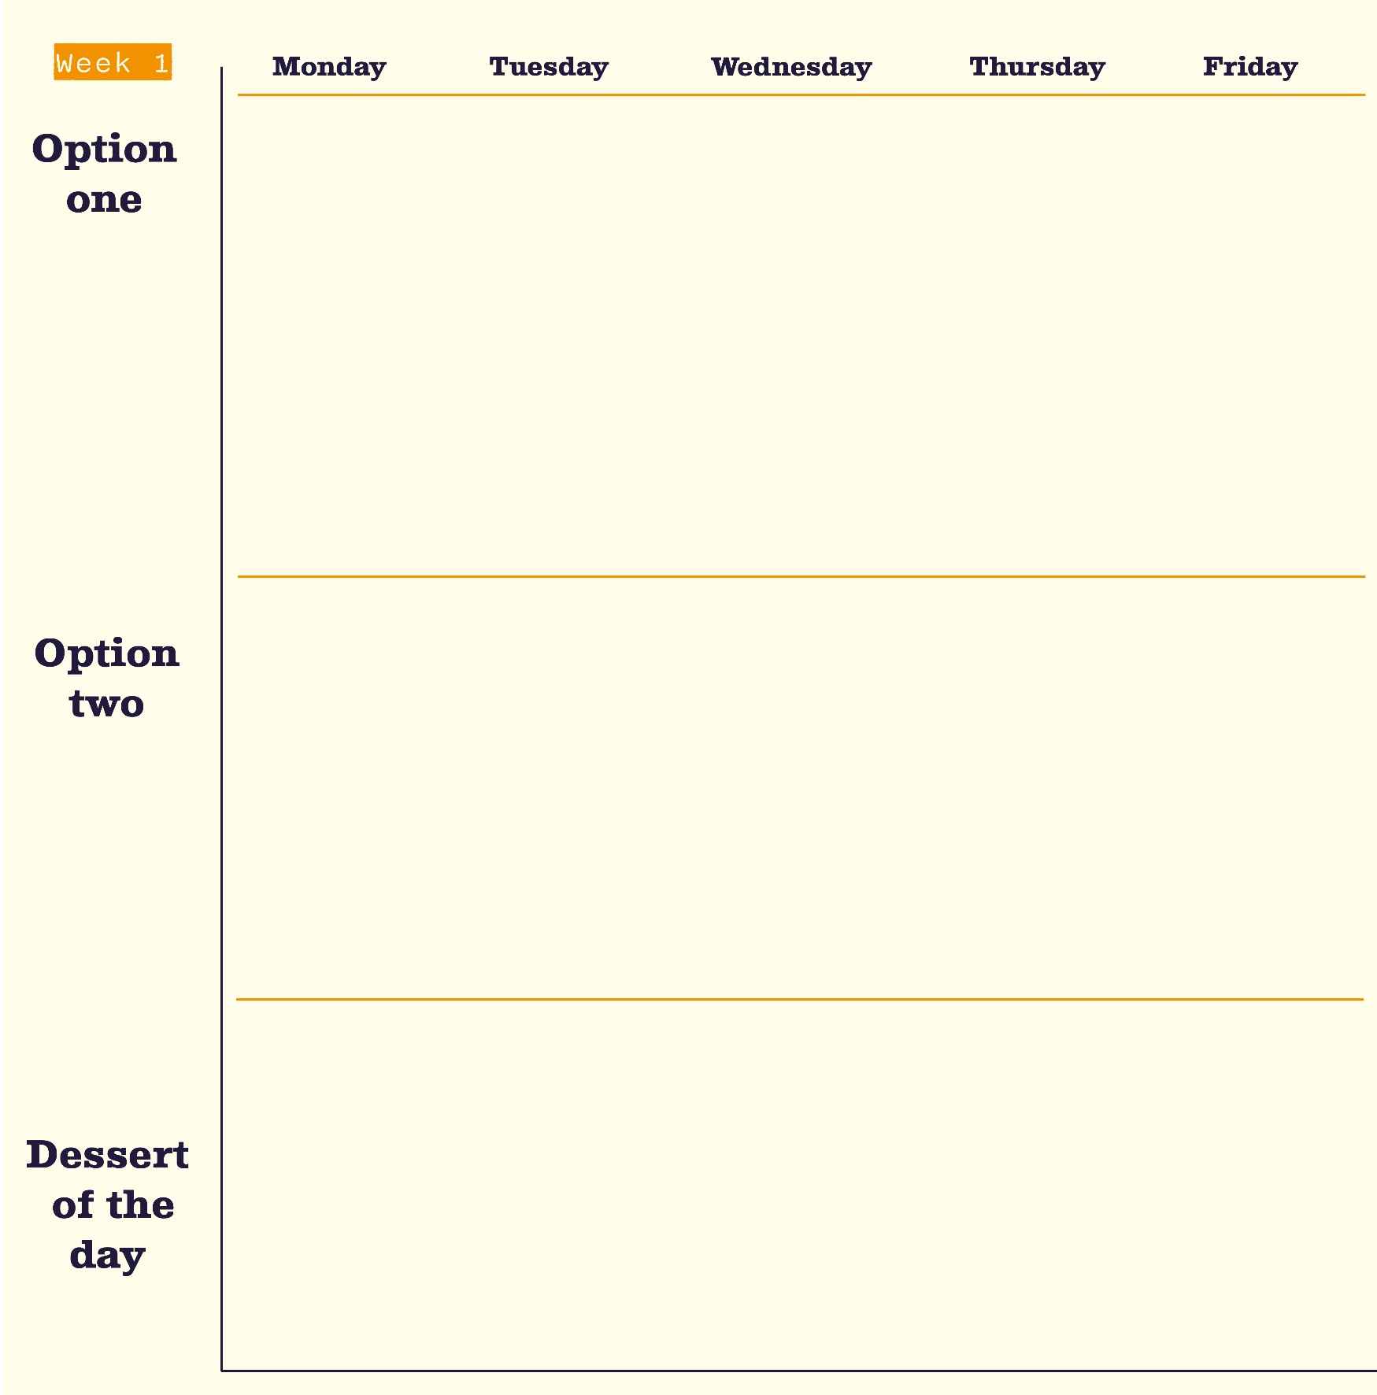





Autumn Winter Menu 2026
(v)
Lemon & Garlic Chicken
Classic Beef Lasagne
with House Salad (ve) & Garlic Bread (ve)
Chicken Korma
with Rice (ve) & Toasted Coconut (ve)
Battered
Pollock or Salmon Fishcake
with Chips (ve) & Peas (ve)
with Garlic Bread (ve) & Toppings (ve)
with Kobez Bread (v), Fattoush Salad (v) & Yoghurt Dip (v)
Falafel & Houmous Bowl (ve)
Garden Vegetable Cottage Pie (ve)
with Carrots (ve) &
Gravy (ve)
Cheesy Bean Filled Pasty (v)
with Chips (ve) & Peas (ve)
Chow
Mein (v)
with Black Bean Sauce
Sweet Potato Tikka (ve)
with Rice (ve) & Onion Salad (ve)
with Mixed Grain Salad (ve) Pickles (ve) & Dip (ve)
Fruit
Muffins (v)
Eton
Mess (v)
Sticky Toffee Apple Crumble (ve)
with Custard (v)
Oaty
Flapjack
(ve)
Chocolate Orange Cookie (ve)
Vegan option
Our hot and cold grab & go selection alongside soup of the day and filled jacket potatoes
Added plant protein
Source of wholemeal

Slide 2




Autumn Winter Menu 2026
Nasi Goreng (v)
Butchers Sausage & Mash
with Onion Gravy (ve)
with Vegetable Spring Rolls (ve) & Curry Sauce (v)
Buffalo Chicken Thigh
Chicken Quesadilla
with Wholemeal Rice (ve) & Cucumber Salsa (ve)
The ultimate fish finger sandwich
with Sweet Chilli & Lime Mayo (v), Chips (ve) & House Salad (ve)
with Herbed Couscous (ve)
Mushroom & Lentil Lasagne Al Forno (v)
Thai Basil Noodles (v)
with Garlic Sautéed Cabbage (ve)
Veggie Sausage & Mash (ve)
with Onion Gravy (ve)
The New York Deli Pickle Burger (v)
with Chips (ve) & House Salad (ve)
Smokey Soya Chilli (ve)
with Wholemeal Rice (ve) & Tomato Salsa (ve)
with Garlic Bread (ve) & House Salad (ve)
Peach Upside Down Cake (v)
with Custard (v)
Jam & Coconut Sponge (v)
Iced Sponge Cake (v)
Cherry Apple Crumble (v)
with Custard (v)
Chocolate Brownie (v)
Vegan option
Our hot and cold grab & go selection alongside soup of the day and filled jacket potatoes
Added plant protein
Source of wholemeal

Slide 3



Autumn Winter Menu 2026
Plant Based Bolognaise
(ve)
Roast Chicken & Stuffing
with All The Trimmings (ve)
Breaded Pollock
with Chips (ve) & Mushy Peas (ve)
Chicken Souvlaki
with Lemon & Herb Rice (ve) & Greek Salad (v)
Amba Chicken
with Grains (ve) & Roasted Broccoli (ve)
with Spaghetti (ve) & Garlic bread (ve)
Garlic & Chilli Tofu Noodles (v)
Greek Feta Honey & Spinach Parcel (v)
Roast Quorn & Stuffing (ve)
with All The Trimmings (ve)
Authentic Chickpea Tagine (ve)
with Grains (ve) & Roasted Broccoli (ve)
Banh Mi Hound Dog (ve)
with Vietnamese Loaded Fries (ve) & Cucumber Salad (ve)
with Sautéed Cabbage (ve)
with Sliced Potatoes (ve) & Greek Salad (v)
Chocolate Swirl
(v)
Pineapple Upside Down Cake (v)
Plum Crumble (ve)
with Custard (v)
Chocolate Crunch Cake (v)
Apple Pie (ve)
with Custard (v)
Vegan option
Our hot and cold grab & go selection alongside soup of the day and filled jacket potatoes
Added plant protein
Source of wholemeal

