Slide 1

Beaminster and Colfox Joint Sixth Form
UCAS: A Parents’ Guide

Slide 2
Key messages
Research courses and institutions carefully before applying
Spend time writing a quality application (including personal statement)
Use your 5 choices wisely – be realistic!
Beware the pull of the unconditional offer
Do not be put off by financial considerations
Ultimately, the quality of the course being offered trumps everything else.

Slide 3
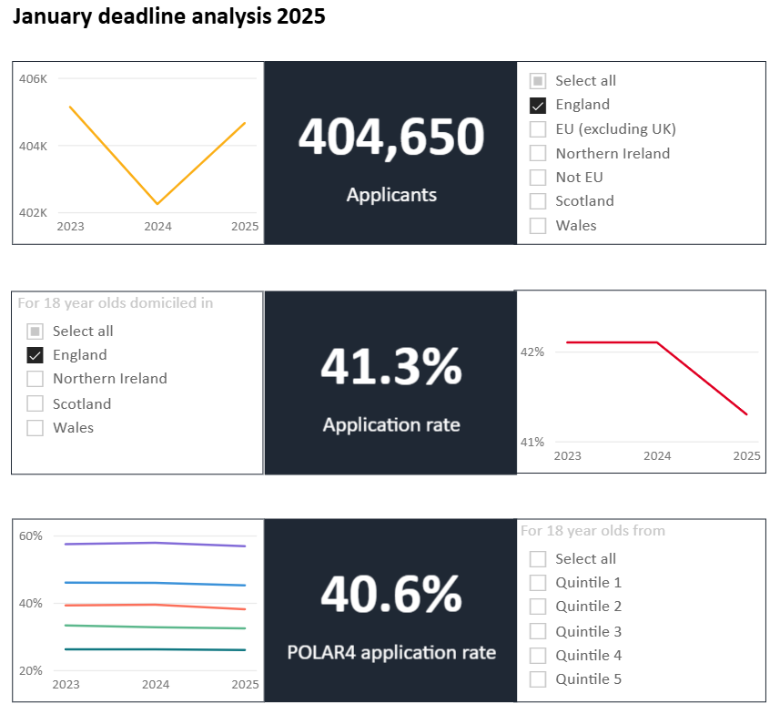

Slide 4
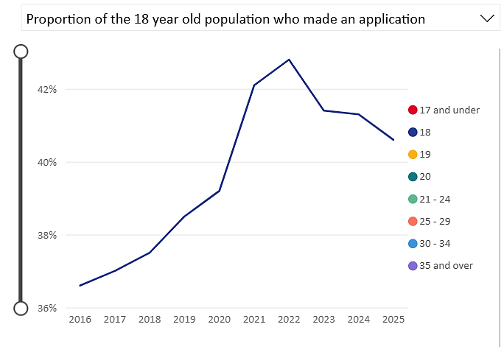

Slide 5
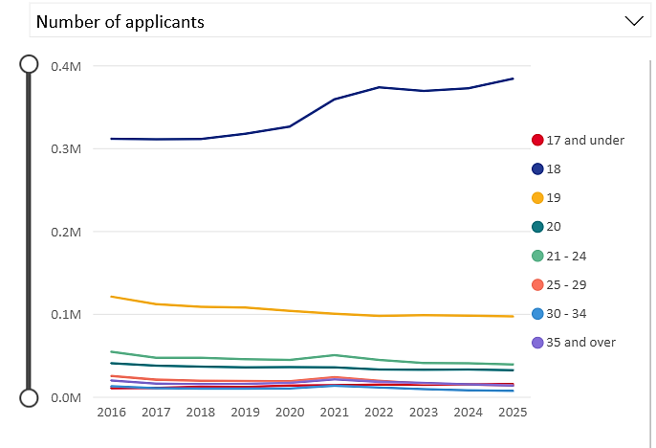
Notes:
RPA = These are not recorded in the Daily Clearing Analysis and will be reported after the cycle has closed. An RPA is a Record of Prior Acceptance, where an application is submitted to UCAS via an institution when an unconditional firm has been offered and accepted by the applicant

Slide 6
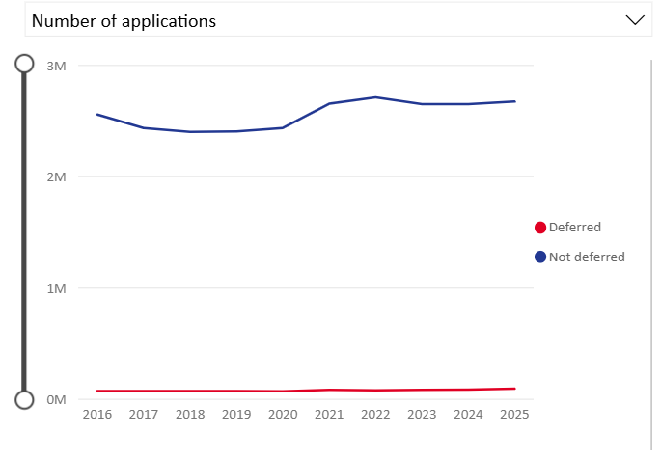

Slide 7
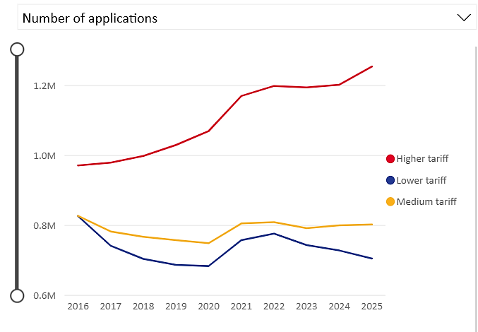

Slide 8
UCAS Undergraduate Applications by Subject, 2025:
Most Popular Subject Group: Business and Law (15.8% of applications)
Other Top Subject Groups: Medicine and Dentistry (13.3%), Humanities (13.1%), Creative Arts and Design (12.7%), Education (12.4%)
Subject Group with Largest Increase: Computing (5.7% increase)
Subject Group with Largest Decrease: Modern Languages (4.1% decrease)

Slide 9
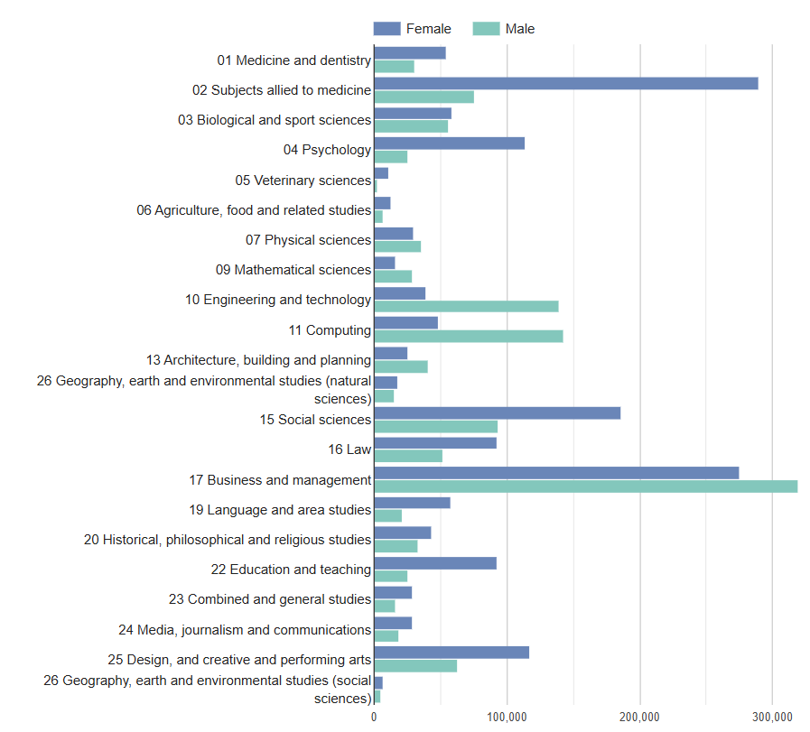
https://www.hesa.ac.uk/

Slide 10
349
Institutions awarding degrees

Slide 11

52,000
courses

Slide 12
Different Types of Degree
Single Honours
Joint Honours
Tripos
'Sandwich' degrees
Degrees with a year abroad

Slide 13
Different Types of Qualification
B.A. B.Sc.
M.A. M.SC.
B.Eng. LL.B Ph.D. D.Phil.
Foundation Degrees & Diplomas

Slide 14

Small Minority Subjects
Some subjects are found in only one place:
e.g.
Viking Studies - UCL
Brewing - Heriot Watt

Slide 15

VETERINARY MEDICINE
Bristol
Cambridge
Edinburgh
Glasgow
Liverpool
Nottingham
Royal Veterinary College
Surrey
There are just 1200 places nationally!

Slide 16

ENGLISH
The same subject e.g. English will not be the same course in any 2 institutions – not even a common core
e.g. non-Shakespearean
American literature
creative writing

Slide 17

HISTORY
‘Modern History’ in some universities may mean nothing before 1900 but in others 1789, 1485 or even when the Romans left Britain.
Ancient
Medieval
Early Modern
Modern

Slide 18

BIOLOGY
Botany
Human
Zoology
Marine Biology
Genetics etc.

Slide 19


ENGINEERING
Civil
Mechanical
Electrical
Aeronautical
General

Slide 20

SPORTS
Sports Science
e.g. Loughborough - AAA - Science A Levels
….. Studies
….. Management
….. Coaching
……Psychology
…..Therapy

Slide 21


There are all sorts of subjects that are not taught or even introduced in school at all…
Adult Studies
Anthropology
Gemmology
Optometry
Viticulture

Slide 22
Key Dates
14th May New UCAS cycle opens
Term 6 (now!) Students start writing
          personal statements
Term 1 (Sept ‘25) References written and applications made
15th October Deadline for Oxbridge and medicine
29th January 2026 Cycle closes
Terms 2 – 6 Offers made, choices made
August 13th Acceptance or clearing

Slide 23



Useful publications
Getting into Oxford & Cambridge (£19)
Sunday Times Good University Guide (£18)
The HEAP guide (£39)

Slide 24
Useful websites
www.theuniguide.co.uk (formerly ‘Which?’ University)
www.ucas.com
www.heaponline.co.uk/
www.whatuni.com
www.slc.co.uk
The school website!

Slide 25
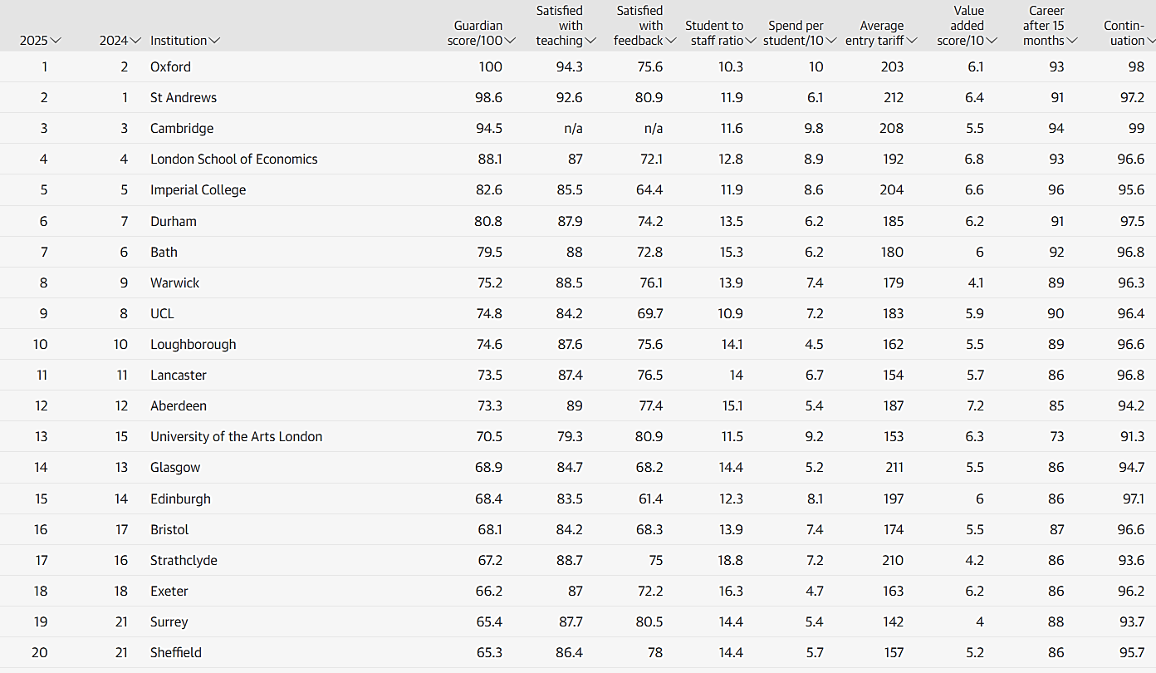

Slide 26

In the news…

Slide 27
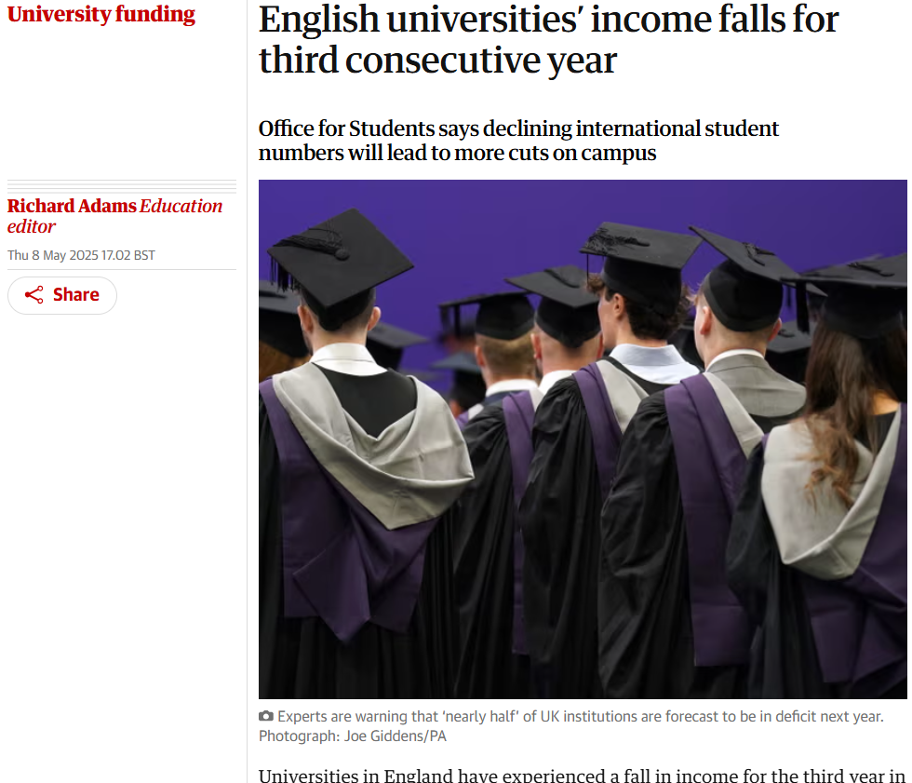

Slide 28
UCAS: The process

Slide 29
Key Information for UCAS Registration:
Website: https://www.ucas.com
Select undergraduate and choose 2026 entry
Choose ‘through school / college’ when asked how you are applying
Buzzword = 2026sjc / Beaminster2026

Slide 30
The Process
Students research and decide on courses and locations
Students set up UCAS ‘Hub’ accounts (they are responsible for user names and passwords. Think carefully about personal email addresses)
Applications made to 5 institutions (spread! Invisible!)
References written, application sent
Payment of £28.50 (by card only)
UCAS processes application
Offers made / interviews
Firm acceptance / insurance / UCAS extra
Results and places confirmed – results day in August
Students start university! (Finance in place via Student Loans Company)

Slide 31

Key factors for successful applications
Some preparation of ‘plan B’
Thorough and effective research (95% regret lack of this!)
Considered choices - weighing aspiration and risk
Contact with university admissions offices
A strong, focussed, error-free personal statement
Timely and effective
management via Track.
Submitted by relevant deadline
Professional academic reference
Associated factors considered (e.g. student loans, accommodation)

Slide 32
A level UCAS Tariff
A levels
A* | 56 (equiv D* at BTEC)
A | 48
B | 40
C | 32 (28 is A* for EPQ)
D | 24 (20 points is A at AS)
E | 16
AS levels (40% A level)
A | 20
B | 16
C | 12
D | 10
E | 6
Extended Project (higher tariff than AS)
A* | 28
A | 24
B | 20
C | 16
D | 12
E | 8
BTEC Diploma
D*D* | 112 (A*A*)
D*D | 104 (BBD)
DD | 96 (AA)
DM | 80
MM | 64
MP | 48 (DD)
PP | 32
BTEC Extended Diploma
D*D*D* | 168 (A*A*A*)
D*D*D | 160
D*DD | 152
DDD | 144
DDM | 128 (ABB)
DMM | 112
MMM | 96 (CCC)
MMP | 80 (BB)
MPP | 64
PPP | 48
BTEC UCAS Tariff
And their equivalents at full A level
Notes:
An offer of three Bs in a tariff format would be 120, if the student has an AS level in another subject this can be added. BTEC have their own tariffs. All these are available with tariff calculators on the UCAS website.

Slide 33


Slide 34
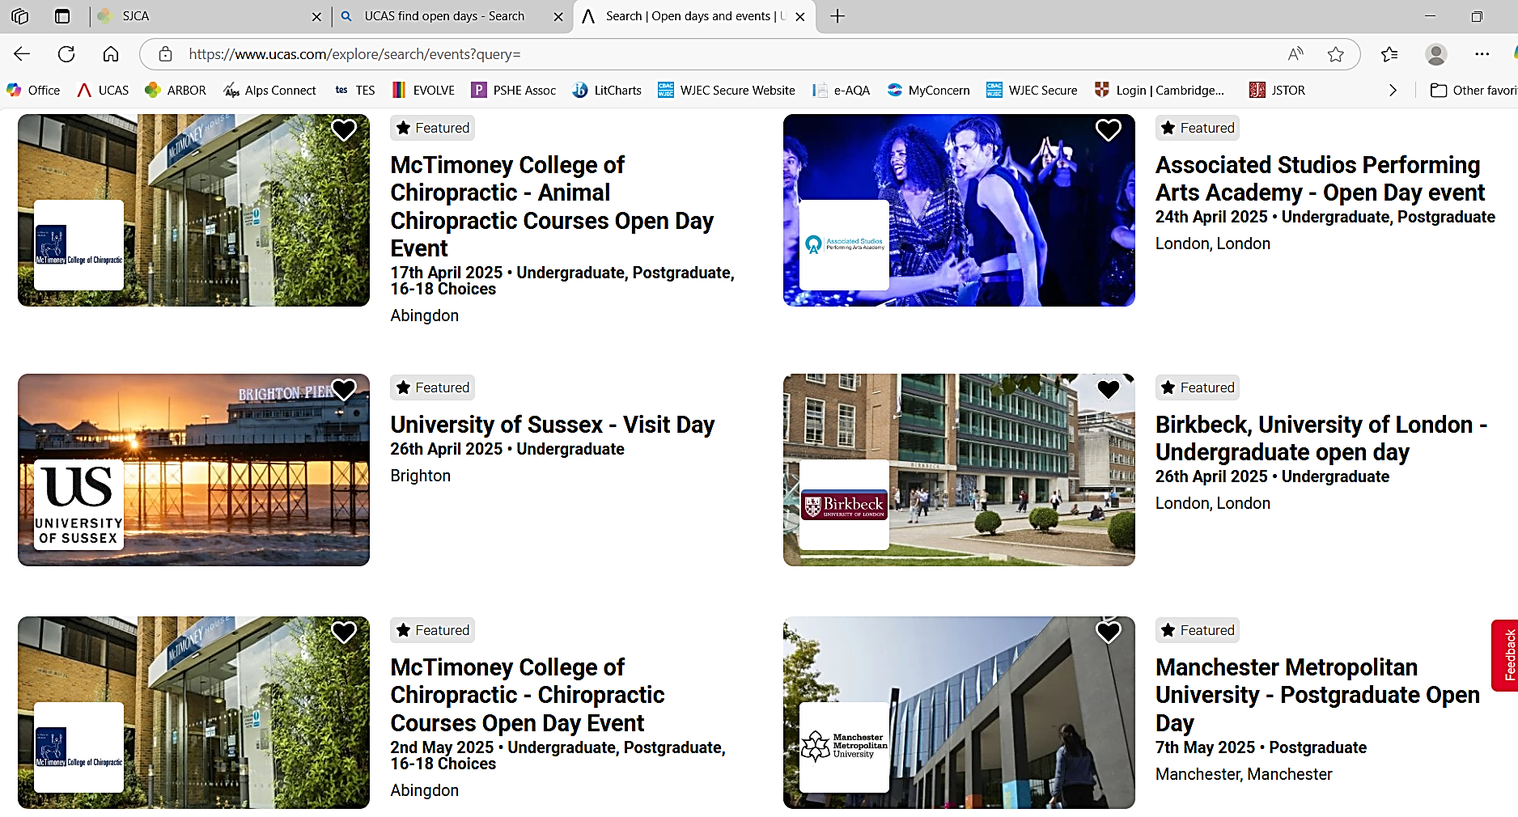

Slide 35
Entering qualifications
All completed, certificated qualifications should be entered with relevant date and grade. Even if a U grade or resit(s).
Qualifications with a future completion or certification date should be entered, with relevant date and result ‘Pending’.
Science practical grade will need to be added in references.

Slide 36
Apply key facts
Some institutions will want grades
Some want 'tariff points'
Some choice restrictions:
  medicine, veterinary science, dentistry (4 max!)
  Oxford or Cambridge (not both!)
Simple application cost:
  £28.50 – for just 1 or 5 applications
Equal consideration and ‘invisibility’.

Slide 37
Common applicant errors
Fail to check entry requirements or take admissions tests.
Qualifications missing or entered incorrectly.
Inappropriate email address or email address not verified.
Tick some boxes (e.g. unspent criminal convictions) in error.
Locked out.
14 day Competition and Markets Authority (CMA) cool off.

Slide 38
From a university perspective
‘With many highly qualified students applying to university, the personal statement is crucial in helping us identify students with the greatest merit and aptitude for our courses.’
University of Manchester

Slide 39
Decisions…
Universities and colleges will review the:
    personal statement
    reference
    qualifications
    admissions test result
    interview
    portfolio
    audition
You’ll get one of three decisions:
    unconditional offer
    conditional offer
    unsuccessful

Slide 40
Applicant replies
Wait for all decisions from all choices, then they can choose one:
firm – if all conditions are met, where they will be placed
insurance – usually lower conditions in case firm conditions are not met
Any other offers must be declined.
They don’t have to have an insurance (14 day CMA cooling off period).

Slide 41
Clearing process
Places secured via Track.
A verbal agreement following initial direct contact must be made.
Eligible applicants will have a ten digit Personal ID number (PID) and a six digit Clearing number.
Should be able to quote both to the universities they contact.
Eligible applicant researches vacancies
Contact
providers to discuss application
Applicant enters choice details in Track
Universities and colleges consider application
If unsuccessful, applicant can start again
Applicant placed on course

Slide 42
References
Something Joint Sixth Form does well – the personal touch
Similar format to personal statement.
Should form a partnership with the personal statement.
Particularly important for competitive courses.
Should be in line with predicted grades.

Slide 43

Notes:
This is a presentation on behalf of the Department for Education to talk to you about higher education student finance in England.
The main aim is to discuss the financial support package available from government for higher education, both tuition fees and your general living costs.
Finance is a big consideration when you’re considering higher education, and it’s important to understand the costs involved: tuition fees, rent and money to help you live are all very important.
Everyone’s circumstances are different when choosing whether to go to University, and sometimes you need help in making the decision on whether to go or not.

Slide 44

What are Student Loans?
Funds loaned to you by the government, to help you cover the costs of going to university.
There are two types of loan:
A Tuition Fee Loan - paid to your university to cover the costs of your tuition
A Maintenance Loan - paid to you to help with living costs - like rent, bills, books and socialising
These loans are very different to commercial loans offered by banks. They are more like a tax…

Slide 45

What is a Tuition Fee Loan?
A Tuition Fee Loan is there to cover the costs of your tuition.
It’s paid directly to your university or college, in three instalments per year.
If you attend a publicly-funded university or college and it’s your first degree (it is for the vast majority of students) you will be eligible for a loan that covers all of your tuition fees

Slide 46
What do Tuition Fees cost?
The highest amount a publicly-funded university or college in England can currently charge is £9535 (up from £9,250 last year) for a full-time course.
Some Higher Education institutions have lower maximum fee levels, depending on whether they meet certain legal requirements. To find out more contact the uni or college you’re interested in studying at.
The important thing to remember is that you will be able to access a tuition fee loan to cover the full amount of your fees at publicly-funded providers.

Slide 47

How do Student Loans work?
You apply through Student Finance England and the money is paid directly to your chosen university or college, so you don’t need to worry about making any payments yourself.
You won’t need to pay anything back –
  Until you've left university or college
    and
  Until you start earning over £25,000 per year (£2083 pm / £480 pw).

Slide 48

Rent, books, food and socialising are all a big part of university life - and they all cost money.
The government also provides a maintenance – or living costs - loan that is designed to help towards your living costs.
The amount of support you can access for living costs depends on your circumstances, including your household income and where you live and study.

Slide 49

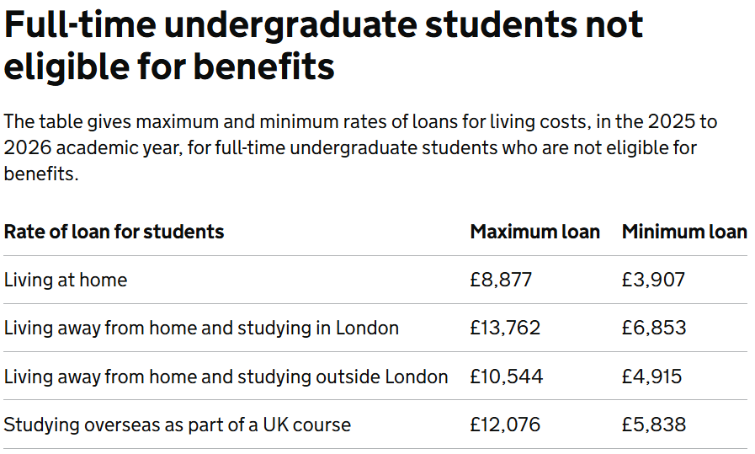
How much support could you be entitled to?
The Maintenance Loan available to eligible students for the last academic year (2022/2023) was:
  Up to £7,324 for students living with your parents
  Up to £8,700 for students living away from home and studying outside London
  Up to £11,354 for students living away from home and studying in London
  If you’re doing a course that involved overseas study as part of UK based course, the maximum loan is £9,963.

Slide 50

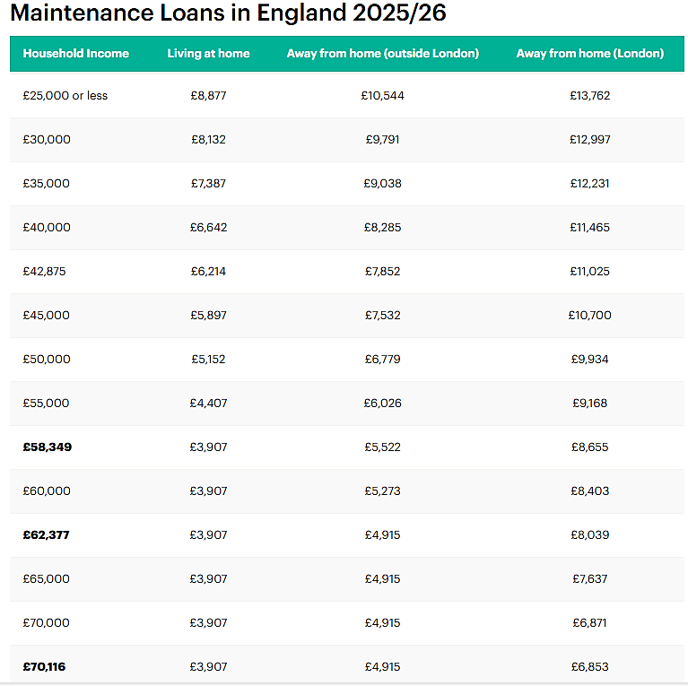
Notes:
From Student Finance Maintenance Loans 2024 - Save the Student

Slide 51
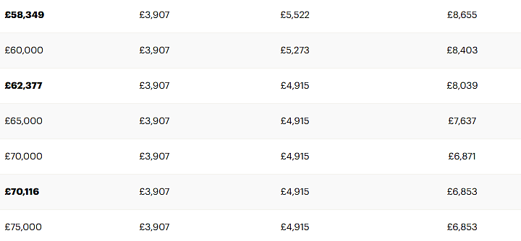
MAXIMUM = £8877 £10,544 £13, 762
MIND THE GAP!
Notes:
From Student Finance Maintenance Loans 2024 - Save the Student

Slide 52

When do you start repaying your loan?
You will only be required to start making any repayments
From the April after you’ve graduated - and
If you’re earning above the threshold of £25,000 per year - and
You only ever repay a percentage of what you earn above that threshold
Your Tuition Fee Loan and Maintenance Loan are combined for repayment purposes, to keep it simple. And the student finance system is designed to ensure your repayments are always affordable.

Slide 53
How much will you pay back?
Once you’re earning over the £25,000 threshold:
You’ll pay 7.3%* of anything you earn above that £25,000 per year.
Your employer will deduct this from your salary automatically, like taxes.
So, let's say your salary is £27,000 a year - you'll pay 7.3% of £2,000. That’s £146…
That’s just over £12 pounds a month.
* the current rate of 7.3 % down from 7.8%. Reviewed every April

Slide 54
How long do you have to pay back?
Until 2024, after 30 years your student loan was written off.
A recent, significant change see this period extend to 40 years!
Therefore, more students will pay off more student loans.

Slide 55
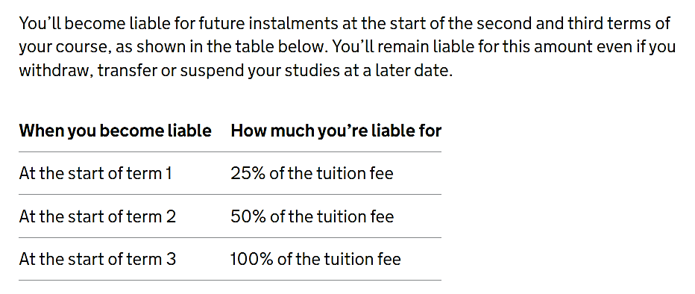
Don’t Drop Out!

Slide 56

You may be entitled to other types of financial support if you choose to go onto higher education – both from the Government and from your chosen university or college.
If you have a recognised disability, you may be entitled to Disabled Students Allowance.
There are also grants available if you have a child or an adult who is financially dependent on you.
Students studying nursing, midwifery and allied health profession courses may be eligible for supplementary funding
Notes:
The leaflets I’ll hand out at the end set out where you can go for more information on this.

Slide 57

Other bursaries and scholarships
Many universities and colleges offer their own bursaries and scholarships to students.
Institutions set their own eligibility criteria for this type of support - for example, you may be eligible if you are from a low-income household, or if you’re a particularly high achiever in a specific subject.
Speak directly to the university or college you’re interested in to find out if there is anything available - sometimes the bursaries are not widely advertised.

Slide 58


Slide 59
Key messages
Research courses and institutions carefully before applying
Spend time writing a quality application (including personal statement)
Use your 5 choices wisely – be realistic!
Beware the pull of the unconditional offer
Do not be put off by financial considerations
Ultimately, the quality of the course being offered trumps everything else.

