Slide 1




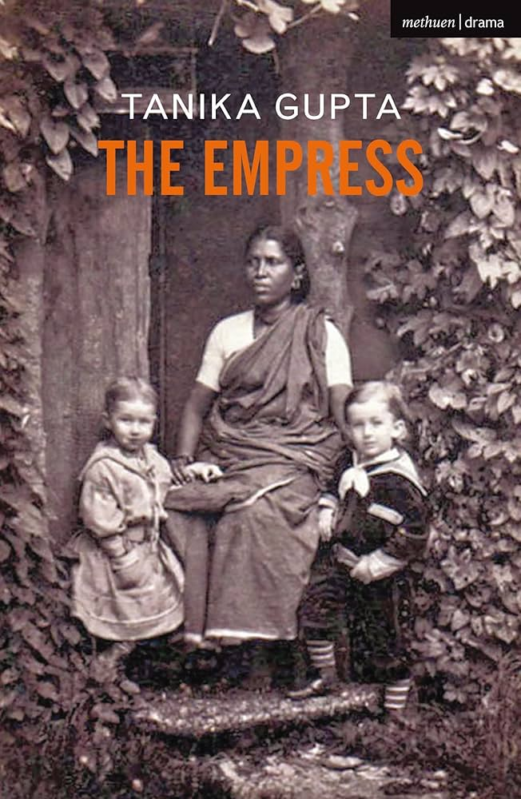

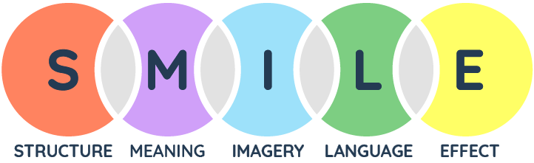

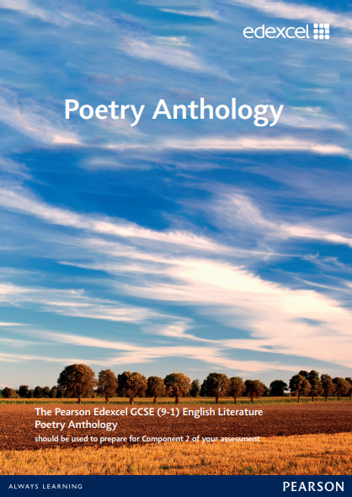







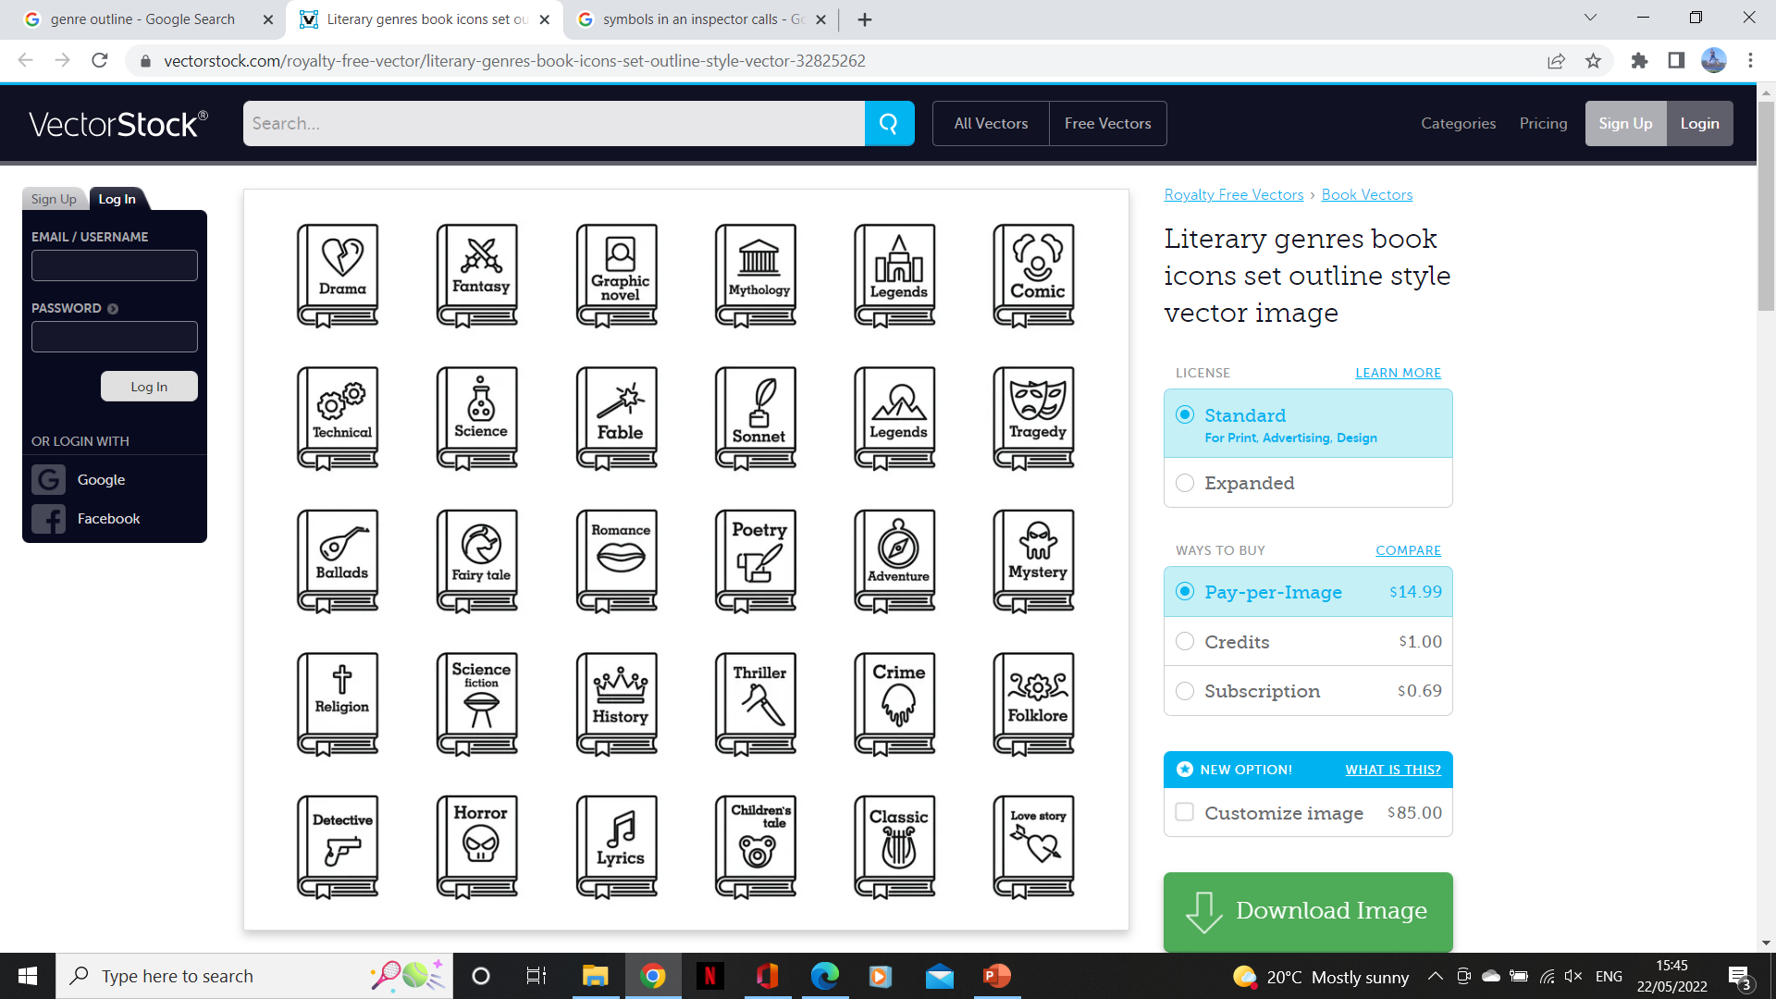


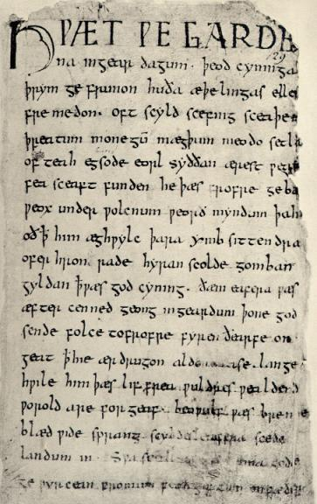






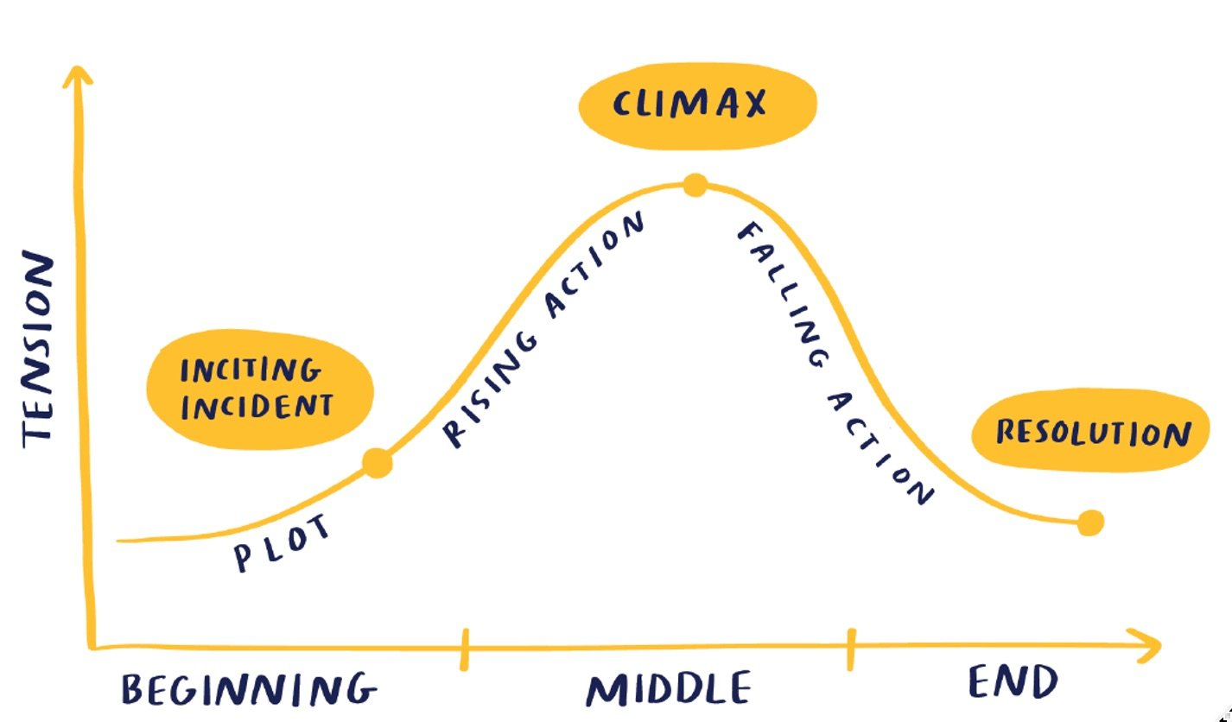

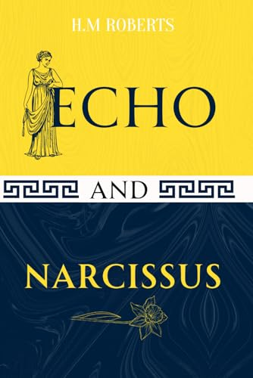


Our Mission Statement: “For me, language is a freedom. As soon as you have found the words with which to express yourself, you are no longer incoherent, you are no longer trapped by your own emotions, by your experiences; you can describe them, you can tell them, you can bring them out of yourself and give them to somebody else.” Jeanette Winterson
English Faculty:
Learning Journey
6th form
EXAMS:
Language Paper 1 & 2
Literature Paper 1 & 2
Spoken Language Assessment
MOCKS:
Language p2
Literature p2
Revision for Mocks:
Language p2
Literature p2
11
Literature p1: Modern Text
The Empress
Revision for Mocks:
Language p1
Literature p1
MOCKS:
Language p1
Literature p1
Literature p2: Unseen Poetry
Spoken Language
Literature p1: Shakespeare Text
Macbeth
Literature p2: Poetry Anthology
Belonging
Language p2: Contemporary Texts
Literature p2: 19th Century Texts
A Christmas Carol
Language p1: Non Fiction Texts
10
GCSE
Bootcamp
9
Bildungsroman
Great Expectations
Identities poetry
Purpose & Perspective
19th Century themes
Shakespeare
Detective reading
Curious Incident
Detective
writing
Language Change
Relationships poetry
Societies
Science Fiction & Dystopia
My Voice
Canonical
texts
Transformations
Frankenstein
8
Poetry Pathways
Allusions
Storytelling
7
From
KS2

Slide 2
Our Mission Statement: “For me, language is a freedom. As soon as you have found the words with which to express yourself, you are no longer incoherent, you are no longer trapped by your own emotions, by your experiences; you can describe them, you can tell them, you can bring them out of yourself and give them to somebody else.” Jeanette Winterson
English Faculty:
Learning Journey
6th form
EXAMS:
Language Paper 1 & 2
Literature Paper 1 & 2
Spoken Language Assessment
MOCKS:
Language p2
Literature p2
Revision for Mocks:
Language p2
Literature p2
11
Literature p1: Modern Text
The Empress
Revision for Mocks:
Language p1
Literature p1
MOCKS:
Language p1
Literature p1
Literature p2: Unseen Poetry
Spoken Language
Literature p1: Shakespeare Text
Macbeth
Literature p2: Poetry Anthology
Belonging
Language p2: Contemporary Texts
Literature p2: 19th Century Texts
A Christmas Carol
Language p1: Non Fiction Texts
10
GCSE
Bootcamp
9
Bildungsroman
Great Expectations
Identities poetry
Purpose & Perspective
19th Century themes
Shakespeare
Detective reading
Curious Incident
Detective
writing
Language Change
Relationships poetry
Societies
Science Fiction & Dystopia
My Voice
Canonical
texts
Transformations
Frankenstein
8
Poetry Pathways
Allusions
Storytelling
7
From
KS2

