Slide 1
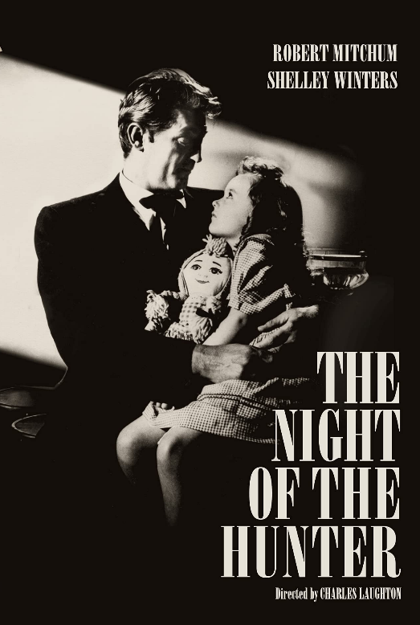



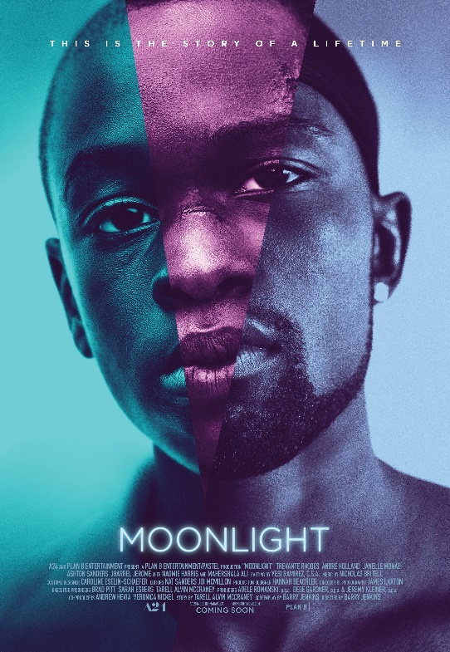

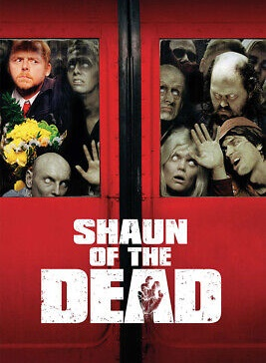
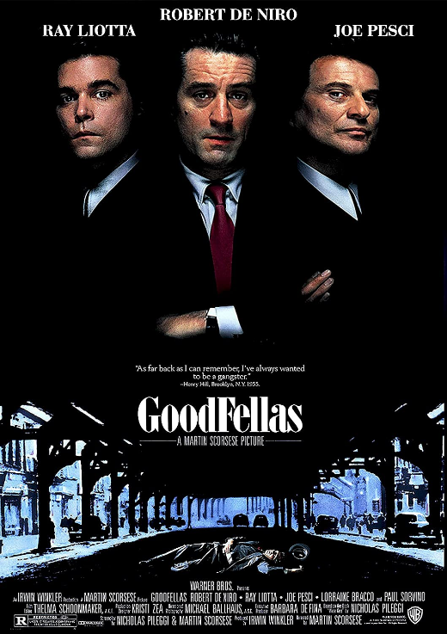
“Reading” List
Here’s a list of films we love and / or recommend you should watch for your film education journey! How many can you tick off?
COMEDY
The Philadelphia Story (1941, Cukor)
Shaun of the Dead (2004, Wright)
Dr. Strangelove (1964, Kubrick)
This Is Spinal Tap (1984, Reiner)
Some Like It Hot (1959, Wilder)
The Big Lebowski (1998, Coen Brothers)
Best in Show (2000, Guest)
Superbad (2007, Mottola)
Withnail & I (1987, Robinson)
Office Space (1999, Judge)
Mean Girls (2004, Waters)
The Grand Budapest Hotel (2014, Anderson)
Palm Springs (2020, Barbakow)
In the Loop (2009, Iannucci)
THRILLER
The Night of the Hunter (1955, Laughton)
Goodfellas (1990, Scorsese)
Rear Window (1954, Hitchcock)
Heat (1995, Mann)
Zodiac (2007, Fincher)
Prisoners (2013, Villeneuve)
Jaws (1975, Spielberg)
Vertigo (1958, Hitchcock)
One Battle After Another (2025, Anderson)
Blue Velvet (Lynch)
Strangers on a Train (1951, Hitchcock)
No Country for Old Men (2007, Coen Brothers)
Children of Men (2006, Cuarón)
OTHER (foreign/avant-garde)
Wings of Desire (1987, Wenders)
Run Lola Run (1998, Tykwer)
Amélie (2001, Jeunet)
In the Mood for Love (2000, Kar-wai)
The Cabinet of Dr. Caligari (1920, Wiene)
Un Chien Andalou (1929, Buñuel & Dalí)
Aguirre, the Wrath of God (1972, Herzog)

Slide 2
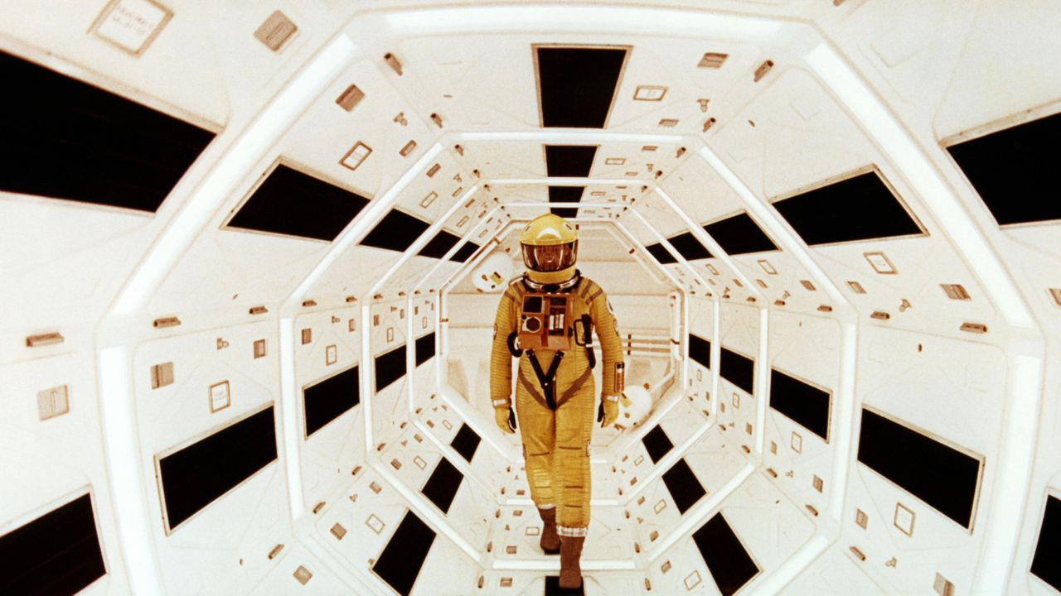
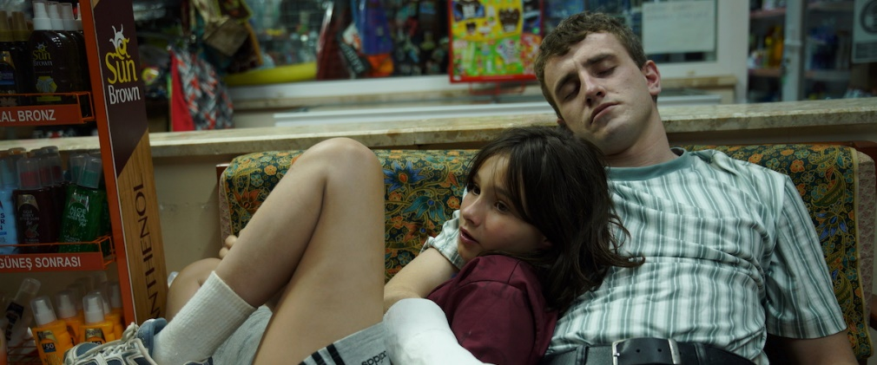
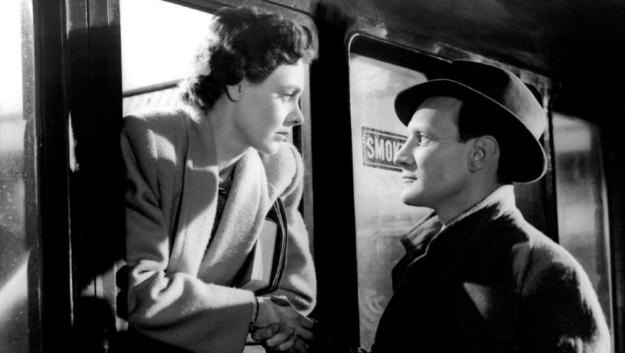

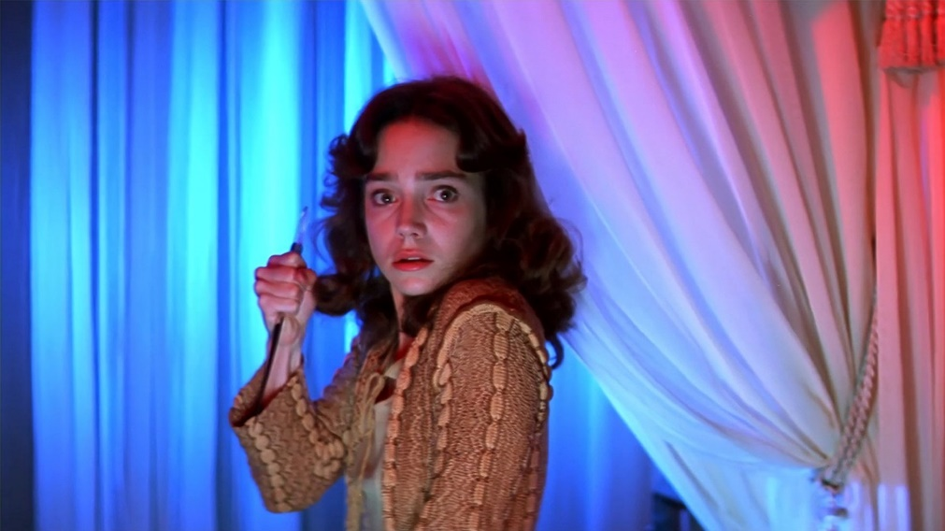
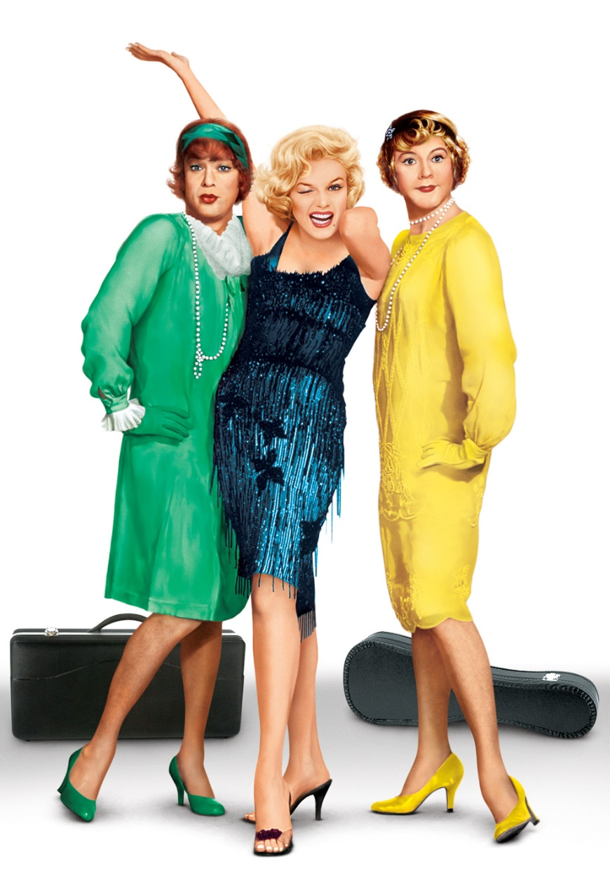

DRAMA
Citizen Kane (1941, Welles)
12 Angry Men (1957, Lumet)
The Godfather (1972, Coppola)
Taxi Driver (1976, Scorsese)
Raging Bull (1980, Scorsese)
Schindler’s List (1993, Spielberg)
American Beauty (1999, Mendes)
There Will Be Blood (2007, Anderson)
Moonlight (2016, Jenkins)
Parasite (2019, Joon-ho)
To Kill a Mockingbird (1962, Mulligan)
Brief Encounter (1945, Lean)
Aftersun (2022, Wells)
The Social Network (2010, Fincher)
Spotlight (2015, McCarthy)
It’s a Wonderful Life (1946, Capra)
‘CLASSICS’
Metropolis (1927, Lang)
City Lights (1931, Chaplin)
Gone with the Wind (1939, Fleming)
Casablanca (1942, Curtiz)
Bicycle Thieves (1948, De Sica)
Sunset Boulevard (1950, Wilder)
Rashomon (1950, Kurosawa)
Singin’ in the Rain (1952, Kelly & Donen)
2001: A Space Odyssey (1968, Kubrick)
Nosferatu (1922, Murnau)
A Streetcar Named Desire (1951, Kazan)
HORROR
Night of the Living Dead (1968, Romero)
Psycho (1960, Hitchcock)
The Exorcist (1973, Friedkin)
The Shining (1980, Kubrick)
The Thing (1982, Carpenter)
The Silence of the Lambs (1991, Demme)
Get Out (2017, Peele)
Midsommar (2018, Aster)
The Witch (2015, Eggers)
Rosemary’s Baby (1968, Polanski)
Suspiria (1977, Argento)
It Follows (2014, Mitchell)
28 Days Later (2002, Boyle)
Alien (1979, Scott)

